Slide 1
Amino acids in space: How meteors may have affected amino acid chirality on Earth
Emily Boggs
Biochemistry
Dr. Timmons
10 December 2012

Slide 2
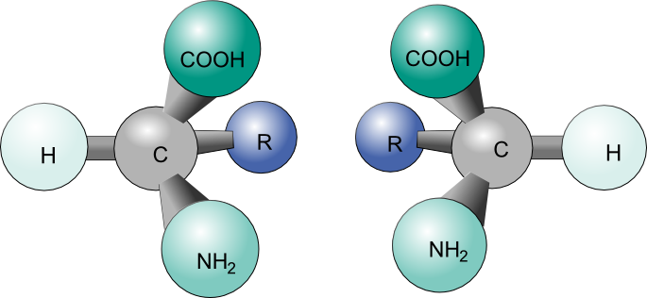
Amino Acid Chirality
All amino acids (except for glycine) have 1 or more chiral centers
Amino acids can exist in either L or D conformations
http://www.math.kit.edu/iag1/~heumann/en

Slide 3
Life is Left!
All amino acids used in biological processes on Earth are of L configurations
Homochirality reduces complexity of these systems
How did amino acid synthesis on pre-life Earth begin to favor L enantiomers?

Slide 4
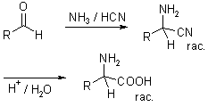
Strecker Synthesis
http://www.organic-chemistry.org/namedreactions/strecker-synthesis.shtm
Abiotic synthesis of amino acids
Produces racemic mixture
So why are all biological amino acids L?

Slide 5
Amino Acids in Meteoroids
Amino acids produced in meteoroids are similar to those on Earth
Created abiotically via Strecker synthesis
Should expect to see racemic mixtures of amino acids in meteorites…
…NO!

Slide 6
The Tagish Lake Meteor
Fell on 18 January 2000 over British Columbia
Widespread publicity ensured quick retrieval by researchers
Less chance for contamination
Enantiomeric mixtures analyzed at the University of Alberta

Slide 7
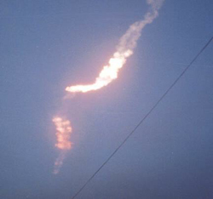
http://reentry.arc.nasa.gov/scienceastro.html

Slide 8
Testing
Tests performed by Glavin et al:
High pressure liquid chromatography (HPLC)
Results compared against amino acid standards
Quantification of enantiomers
Time-of-flight mass spectroscopy (TOF-MS)
To further refine amino acid identification by molecular mass
Tandem mass spectroscopy and isotopic ratio mass spectrometry (MS-IRMS)
To determine the level of carbon-13 enrichment

Slide 9
Results
In the two samples tested for enantiomeric composition, large L_{ee}s were observed for aspartic acid, glutamic acid, serine, and threonine
Alanine was much closer to a racemic mixture

Slide 10
Not Contaminated!
Previous studies on meteorites were accused of allowing for terrestrial contamination
A large L_{ee} could be explained by an influx of terrestrial amino acids shortly after impact.
Glavin et al. used the high concentrations of carbon-13 to verify that the samples tested were extraterrestrial

Slide 11
Crystallization Theory
Glavin et al. posited the following theory regarding enantiomeric
Three assumptions:
Amino acids are more likely to racemize while in solution than while precipitated as a solid
Larger amino acid crystals are more stable than smaller ones and are less likely to dissolve back into solution
A small enantiomeric excess is already present

Slide 12
Crystallization Theory
Some amino acids like aspartic acid, glutamic acid, and threonine form enantiopure crystals
Other amino acids like alanine form racemic crystals

Slide 13
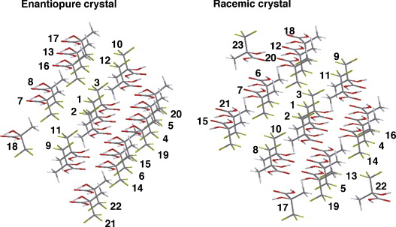
Seiji Tsuzuki, Hideo Orita, Hisanori Ueki, Vadim A. Soloshonok, First principle lattice energy calculations for enantiopure and racemic crystals of α-(trifluoromethyl)lactic acid: Is self-disproportionation of enantiomers controlled by thermodynamic stability of crystals?, Journal of Fluorine Chemistry, Volume 131, Issue 4, April 2010, Pages 461-466, ISSN 0022-1139, 10.1016/j.jfluchem.2009.12.018.

Slide 14
Crystallization Theory
For enantiopure crystals, the excess major enantiomer will form slightly larger crystals
Crystals of minor enantiomer are smaller and more likely to dissolve
Since minor enantiomer is more likely to remain in solution, it has a higher chance of racemizing into the major enantiomer
“Runaway snowball” effect

Slide 15
Crystallization Theory
For racemic crystals, only 50-50 enantiomer crystals will form
An excess of one enantiomer means there will be more of it in solution
The excess enantiomer will be more likely to racemize into the other enantiomer until equilibrium is reached

Slide 16
Circular Polarized Light (CPL)
Posited as possible explanation for small initial enantiomeric excess
Can degrade molecules of certain chirality while leaving other alone
Right-handed CPL degrades L configurations
Left-handed CPL degrades D configurations

Slide 17
However…
Theory rejected by Glavin et al.
Aspartic acid located too far inside the meteorite to have been affected by radiation
Aspartic acid precursor (3-oxopropanoic acid) is achiral
Mechanism of homochirality understood…
Cause still unknown!

Slide 18
References
Fisher, G. H., Petrucelli, L., Gardner, C., Emory, C., Frey, W. H., Amaducci, L. Sorbi, S., Sorrention, G., Borghi, M., D'Aniello, A. (1994) Free D-amino acids in human cerebrospinal fluid of Alzheimer disease, multiple sclerosis, and healthy control subjects. Mol. Chem. Neuropathol. 23, 115-124.
Chyba, C., Sagan, C. (1992) Endogenous production, exogenous delivery and impact-shock synthesis of organic molecules: an inventory for the origins of life. Nature. 9, 125-132.
Acworth, I. N., Zhang, Q., Phattanarudee, S., Waraska, J., Maher, T. J. (2008) A Method for the Routine Determination of a Free D-Serine and D-Aspartic Acid in Brain Tissue Extracts. PDF. http://www.esainc.com/docs/spool/D-Serine_Pittcon_2008.pdf
Bailey, J., Chrysostomou A., Hough, J. H., Gledhill, T. M., McCall, A., Clark, S., Menard, F., Tamura, M. (1998) Circular Polarization in Star-Formation Regions: Implications for Biomolecular Homochirality. Science. 281, 672-674.

Slide 19
References
Nuevo, M., Meierhenrich, U. J., Munoz Caro, G. M., Dartois, E., d'Hendecourt, L., Deboffle, D., Auger, G., Blanot, D., Bredehoeft, J. H., Nahon, L. (2006) The effects of circularly polarized light on amino acid enantiomers produced by the UV irradiation of interstellar ice analogs. Astronomy & Astrophysics. 457, 741-751.
Noorduin, W. L., et al. (2009) Complete chiral symmetry breaking of an amino acid derivative directed by circularly polarized light. Nature Chemistry. 1, 729-732.
Glavin, D. P., Elsila, J. E., Burton, A. S., Callahan, M. P., Dworkin, J. P., Hilts, R. W., Herd, D. K. (2012) Unusual nonterrestrial L-proteinogenic amino acid excesses in the Tagish Lake meteorite. Meteoritics & Planetary Science. 47, 1347-1364.
ScienceDaily. “How Life Turned Left: Meteorite Fragments Help Explain Why Living Things Only Use Molecules With Specific Orientations.” July 25, 2012.

Slide 20
QUESTIONS?

